Slide 1
MODULE II
File Organization:
Indexing Structures for Files and Physical Database Design

Slide 2
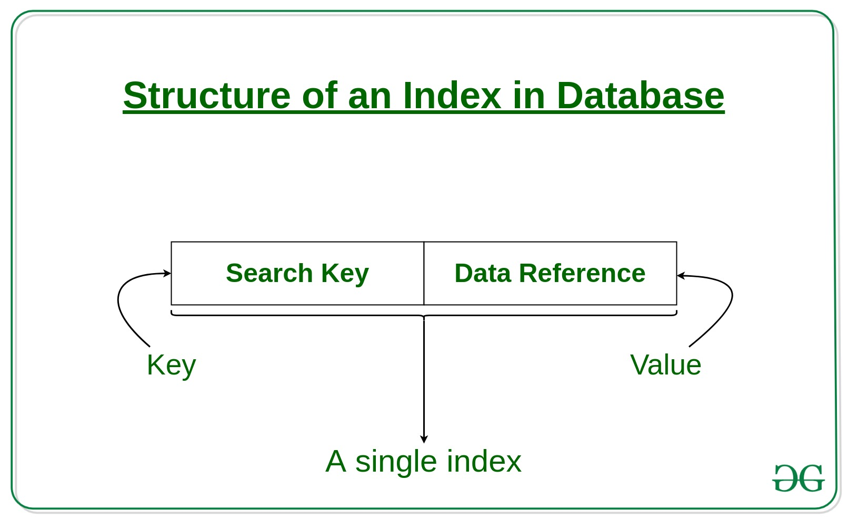
Introduction
Indexes used to speed up record retrieval in response to certain search conditions
Index structures provide secondary access paths
Any field can be used to create an index
  Multiple indexes can be constructed
Most indexes based on ordered files
  Tree data structures organize the index
Notes:
Indexing is a way to optimize the performance of a database by minimizing the number of disk accesses required when a query is processed. It is a data structure technique which is used to quickly locate and access the data in a database.
The first column is the Search key that contains a copy of the primary key or candidate key of the table. These values are stored in sorted order so that the corresponding data can be accessed quickly.
Note: The data may or may not be stored in sorted order.
The second column is the Data Reference or Pointer which contains a set of pointers holding the address of the disk block where that particular key value can be found.

Slide 3
17.1 Types of Single-Level Ordered Indexes
Ordered index similar to index in a textbook
Indexing field (attribute)
  Index stores each value of the index field with list of pointers to all disk blocks that contain records with that field value
Values in index are ordered
Primary index
  Specified on the ordering key field of ordered file of records
Notes:
Ordered Index File: In this, the indices are based on a sorted ordering of the values. These are generally fast and a more traditional type of storing mechanism.
Primary Index:
If the index is created on the basis of the primary key of the table, then it is known as primary indexing. These primary keys are unique to each record and contain 1:1 relation between the records.
As primary keys are stored in sorted order, the performance of the searching operation is quite efficient.

Slide 4
Types of Single-Level Ordered Indexes (cont’d.)
Clustering index
  Used if numerous records can have the same value for the ordering field
Secondary index
  Can be specified on any nonordering field
  Data file can have several secondary indexes
Notes:
Clustering index is defined on an ordered data file. The data file is ordered on a non-key field. In some cases, the index is created on non-primary key columns which may not be unique for each record. In such cases, in order to identify the records faster, we will group two or more columns together to get the unique values and create index out of them. This method is known as the clustering index. Basically, records with similar characteristics are grouped together and indexes are created for these groups.
For example, students studying in each semester are grouped together. i.e. 1st Semester students, 2nd semester students, 3rd semester students etc. are grouped.

Slide 5
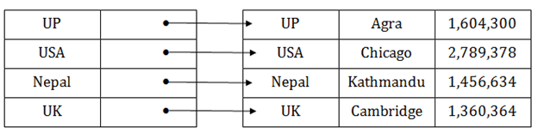
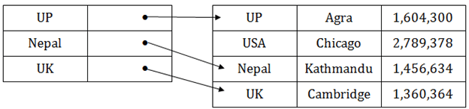

Primary Indexes
Ordered file with two fields
  Primary key, K(i)
  Pointer to a disk block, P(i)
One index entry in the index file for each block in the data file
Indexes may be dense or sparse
  Dense index has an index entry for every search key value in the data file
  Sparse index has entries for only some search values
Dense Index
Sparse Index
Notes:
If the index is created on the basis of the primary key of the table, then it is known as primary indexing. These primary keys are unique to each record and contain 1:1 relation between the records.
As primary keys are stored in sorted order, the performance of the searching operation is quite efficient.
The primary index can be classified into two types: Dense index and Sparse index.
Primary Index is an ordered file whose records are of fixed length with two fields. The first field of the index replicates the primary key of the data file in an ordered manner, and the second field of the ordered file contains a pointer that points to the data-block where a record containing the key is available.

Slide 6
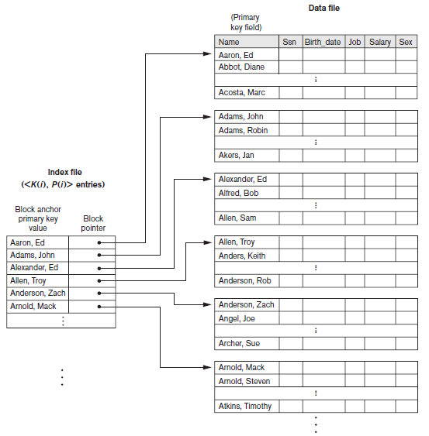
Primary Indexes (cont’d.)
Figure 17.1 Primary index on the ordering key field of the file shown in Figure 16.7

Slide 7
Primary Indexes (cont’d.)
Major problem: insertion and deletion of records
  Move records around and change index values
  Solutions
    Use unordered overflow file
    Use linked list of overflow records

Slide 8
Clustering Indexes
Clustering field
  File records are physically ordered on a nonkey field without a distinct value for each record
Ordered file with two fields
  Same type as clustering field
  Disk block pointer
Notes:
When more than two records are stored in the same file these types of storing known as cluster indexing. By using the cluster indexing we can reduce the cost of searching reason being multiple records related to the same thing are stored at one place and it also gives the frequent joining of more than two tables (records).
Clustering index is defined on an ordered data file. The data file is ordered on a non-key field. In some cases, the index is created on non-primary key columns which may not be unique for each record. In such cases, in order to identify the records faster, we will group two or more columns together to get the unique values and create index out of them. This method is known as the clustering index. Basically, records with similar characteristics are grouped together and indexes are created for these groups.

Slide 9
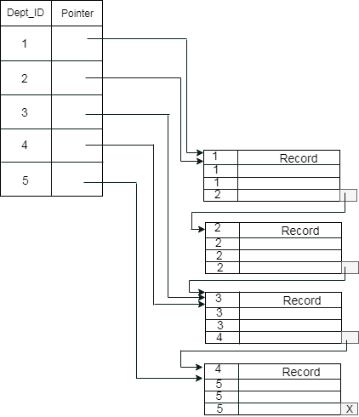
Clustering Indexes (cont’d.)
Suppose a company contains several employees in each department. Suppose we use a clustering index, where all employees which belong to the same Dept_ID are considered within a single cluster, and index pointers point to the cluster as a whole. Here Dept_Id is a non-unique key.
Figure 17.2 A clustering index on the Dept_number ordering nonkey field of an EMPLOYEE file
Notes:
A clustered index can be defined as an ordered data file. Sometimes the index is created on non-primary key columns which may not be unique for each record.
In this case, to identify the record faster, we will group two or more columns to get the unique value and create index out of them. This method is called a clustering index.
The records which have similar characteristics are grouped, and indexes are created for these group.

Slide 10
Secondary Indexes
Provide secondary means of accessing a data file
  Some primary access exists
Ordered file with two fields
  Indexing field, K(i)
  Block pointer or record pointer, P(i)
Usually need more storage space and longer search time than primary index
  Improved search time for arbitrary record
Notes:
A non clustered index just tells us where the data lies, i.e. it gives us a list of virtual pointers or references to the location where the data is actually stored. Data is not physically stored in the order of the index. Instead, data is present in leaf nodes. For eg. the contents page of a book. Each entry gives us the page number or location of the information stored. The actual data here(information on each page of the book) is not organized but we have an ordered reference(contents page) to where the data points actually lie. We can have only dense ordering in the non-clustered index as sparse ordering is not possible because data is not physically organized accordingly.
It requires more time as compared to the clustered index because some amount of extra work is done in order to extract the data by further following the pointer. In the case of a clustered index, data is directly present in front of the index.

Slide 11
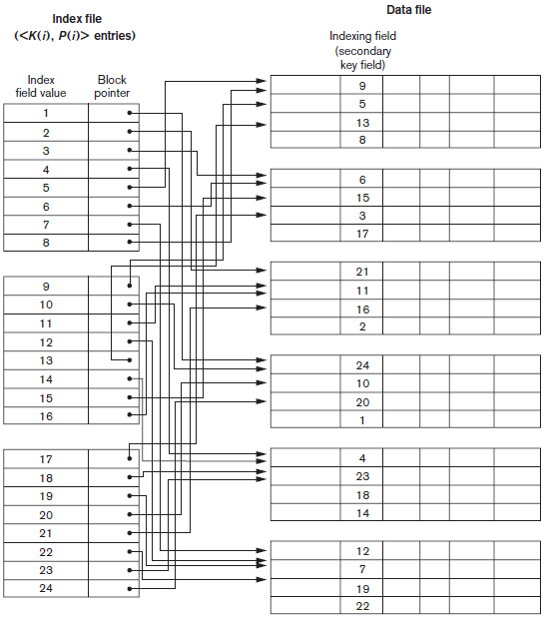
Secondary Indexes (cont’d.)
Figure 17.4 Dense secondary index (with block pointers) on a nonordering key field of a file.

Slide 12
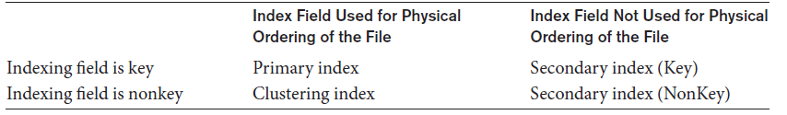
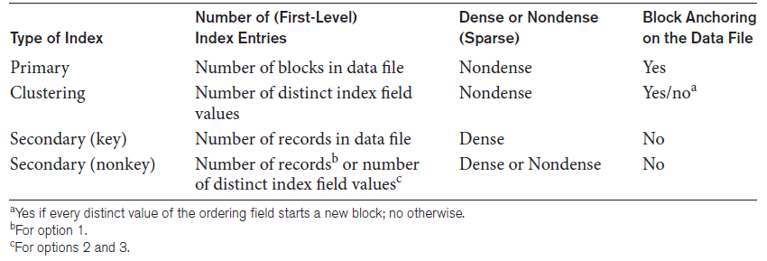
Types of Single-Level Ordered Indexes (cont’d.)
Table 17.1 Types of indexes based on the properties of the indexing field
Table 17.2 Properties of index types

Slide 13
17.2 Multilevel Indexes
Designed to greatly reduce remaining search space as search is conducted
Index file
  Considered first (or base level) of a multilevel index
Second level
  Primary index to the first level
Third level
  Primary index to the second level
Notes:
In the sparse indexing, as the size of the table grows, the size of mapping also grows. These mappings are usually kept in the primary memory so that address fetch should be faster. Then the secondary memory searches the actual data based on the address got from mapping. If the mapping size grows then fetching the address itself becomes slower. In this case, the sparse index will not be efficient. To overcome this problem, secondary indexing is introduced.
In secondary indexing, to reduce the size of mapping, another level of indexing is introduced. In this method, the huge range for the columns is selected initially so that the mapping size of the first level becomes small. Then each range is further divided into smaller ranges. The mapping of the first level is stored in the primary memory, so that address fetch is faster. The mapping of the second level and actual data are stored in the secondary memory (hard disk).

Slide 14
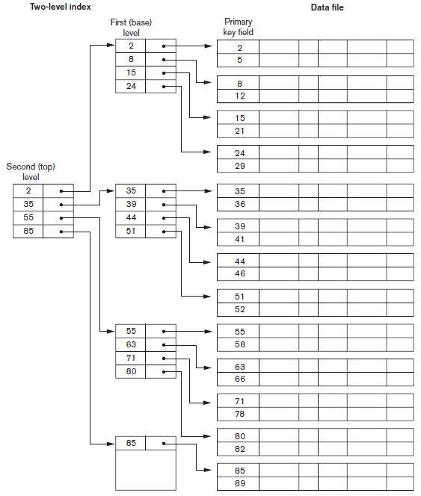
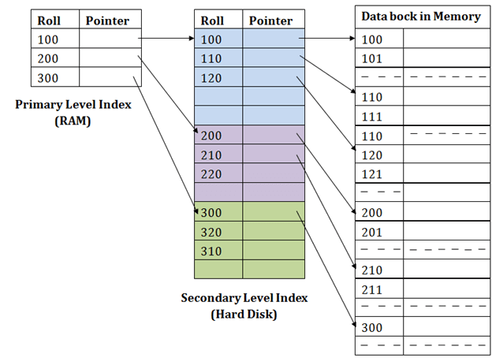
Figure 17.6 A two-level primary index resembling ISAM (indexed sequential access method) organization
Example 2

